Slide 1
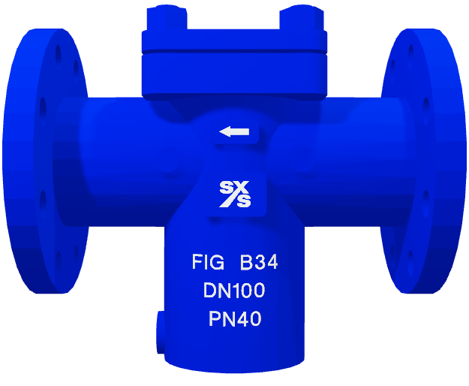
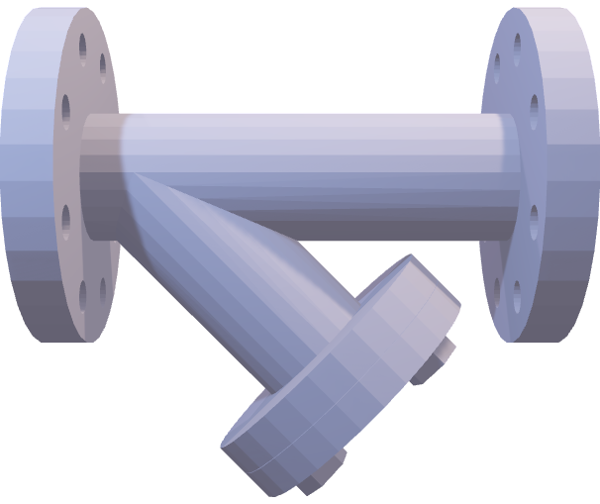
Quick opening style covers,
Additional vent ports and differential pressure taps,
Higher flow capacity despite smaller open ratio areas, thanks to a straighter flow path,
Chamber covers can be opened without process fluid draining out whilst installed horizontally. This is beneficial in more hazardous processes,
Better suited to transferring fluids at higher velocities,
Ideal for larger pipeline applications which require quick access to the strainer.
Superior flushing capabilities, thanks to inherent built-in blow-down ports,
Better value for money with initial costs,
Faster shipment times due to their status as a set-item with minimal customisation capabilities,
Greater levels of flexibility,
A wider selection of materials for construction,
A broader range of pressure classes,
Larger open ratio areas than T-type strainers.

